Slide 1
Object-Oriented Programming (OOP)
Week – 15
May 18-22, 2020
Instructor: Basit Ali
Email: basit.jasani@nu.edu.pk
Object-Oriented Programming (OOP)

Slide 2
List in C++ STL
Lists are sequence containers that allow non-contiguous memory allocation
As compared to vector, list has slow traversal, but once a position has been found, insertion and deletion are quick
Normally, when we say a List, we talk about LINKED LIST (DS Course)

Slide 3
Some useful functions of list
front() – Returns the value of the first element in the list
back() – Returns the value of the last element in the list
push_front(g) – Adds a new element ‘g’ at the beginning of the list
push_back(g) – Adds a new element ‘g’ at the end of the list.
pop_front() – Removes the first element of the list, and reduces size of the list by 1.
pop_back() – Removes the last element of the list, and reduces size of the list by 1
sort() – Sorts the list in increasing order
reverse() –
empty(), insert(), erase() and size() : Same as Vectors

Slide 4
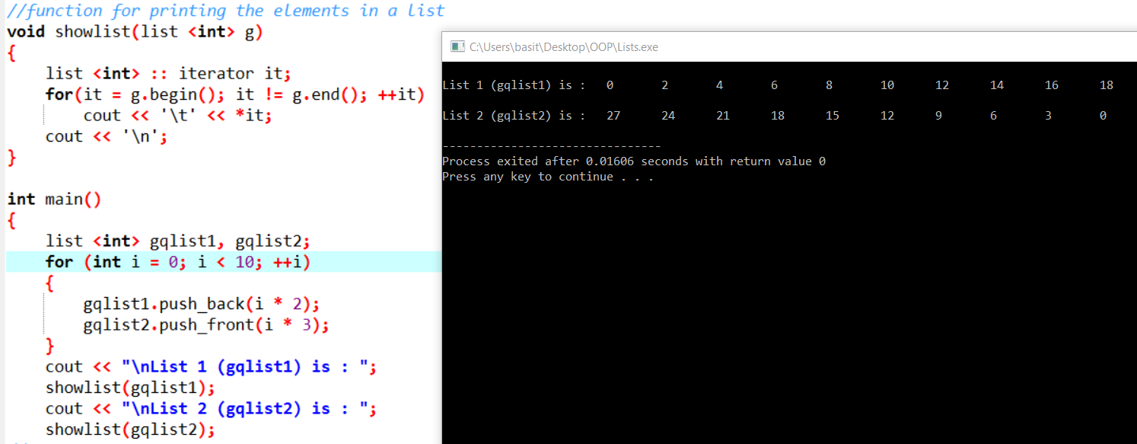
Example

Slide 5
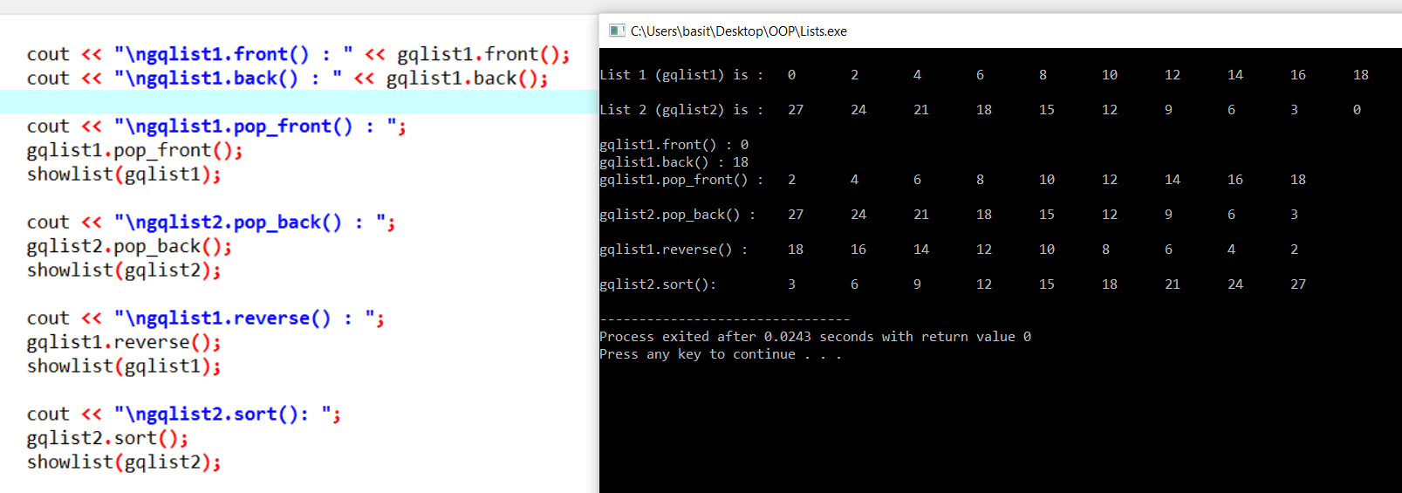
Example

Slide 6
Set in C++ STL
Sets are a type of associative containers in which each element has to be unique, because the value of the element identifies it
The value of the element cannot be modified once it is added to the set, though it is possible to remove and add the modified value of that element.

Slide 7
Some basic functions associated with Set
begin() – Returns an iterator to the first element in the set.
end() – Returns an iterator to the theoretical element that follows last element in the set.
size() – Returns the number of elements in the set.
max_size() – Returns the maximum number of elements that the set can hold.
empty() – Returns whether the set

Slide 8
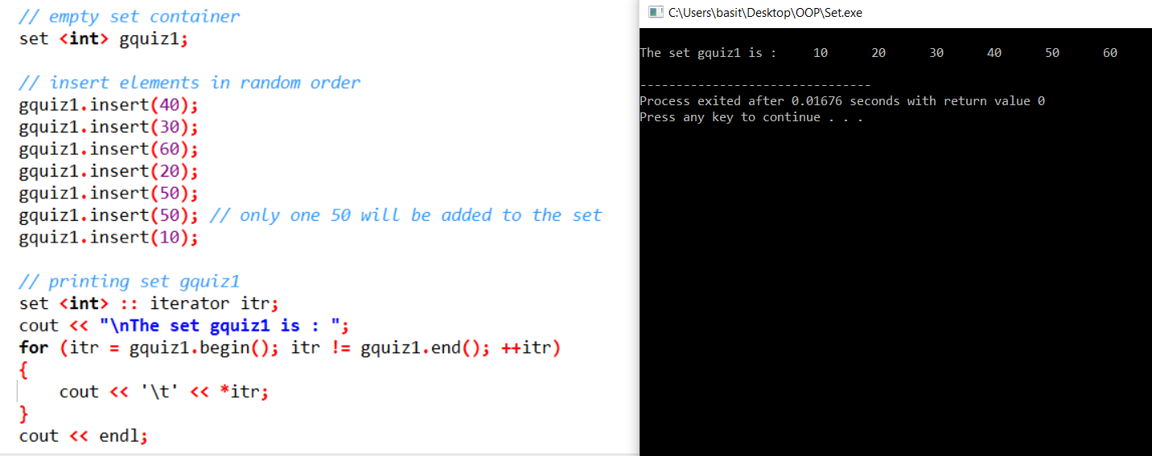
Example

Slide 9
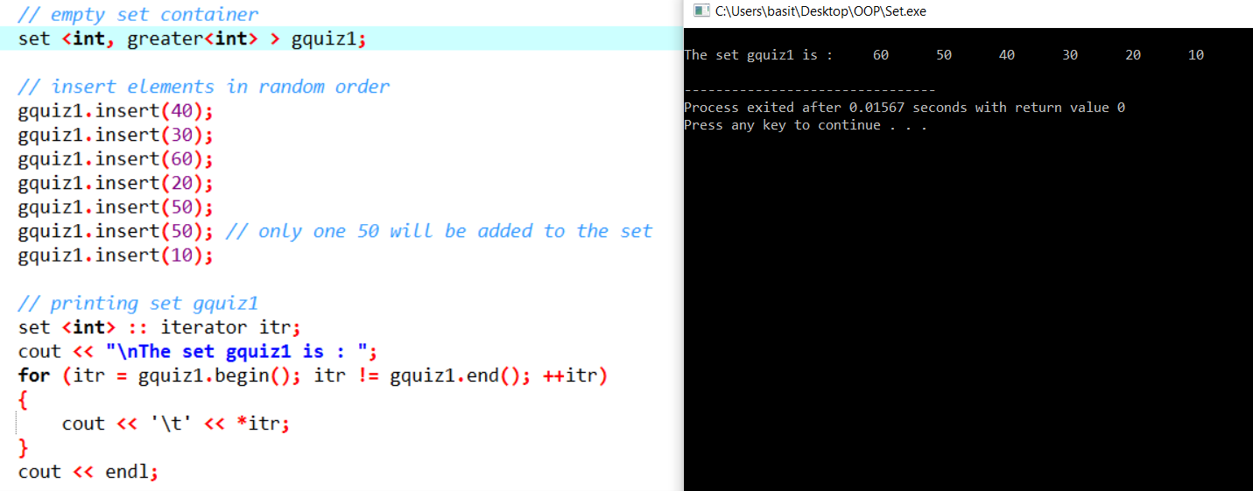
Example

Slide 10
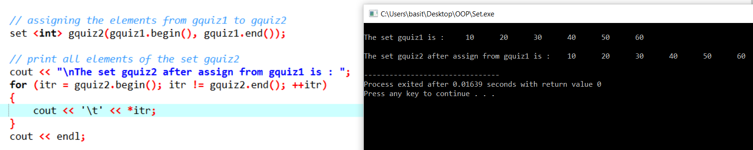
Example

Slide 11
Map in C++ STL
Maps are associative containers that store elements in a mapped fashion
Each element has a key value and a mapped value
No two mapped values can have same key values

Slide 12
Some basic functions associated with Map
begin() – Returns an iterator to the first element in the map
end() – Returns an iterator to the theoretical element that follows last element in the map
size() – Returns the number of elements in the map
empty() – Returns whether the map is empty
pair insert(keyvalue, mapvalue) – Adds a new element to the map
erase(iterator position) – Removes the element at the position pointed by the iterator
erase(const g)– Removes the key value ‘g’ from the map
clear() – Removes all the elements from the map

Slide 13
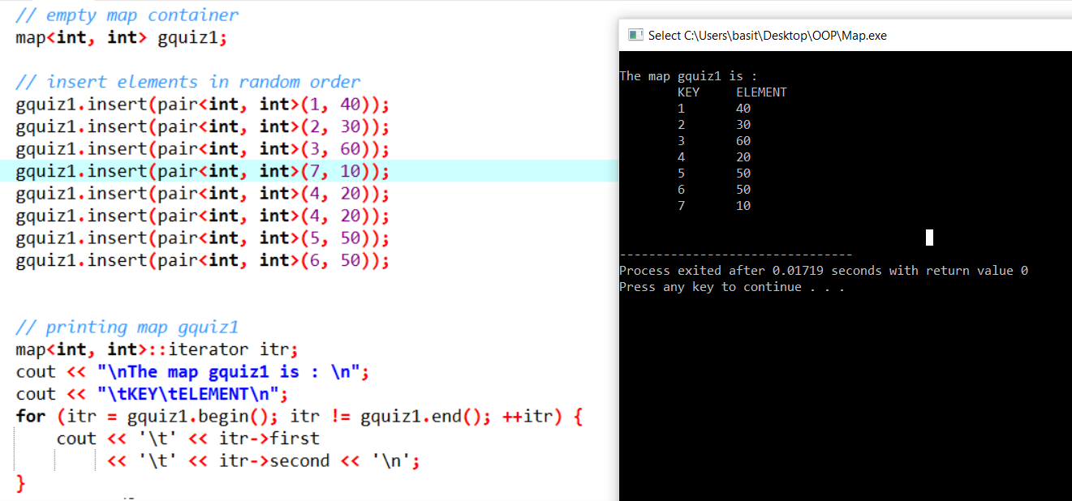
Example

